Slide 1
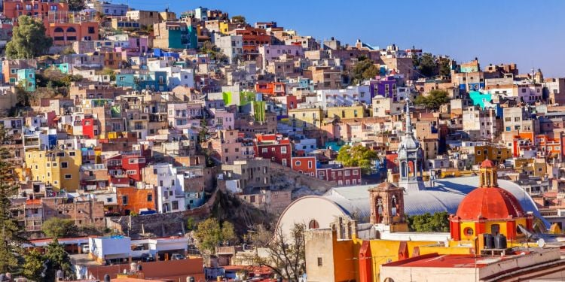
Analyzing Housing in Mexico Project
By
Aderounmu Damilare

Slide 2
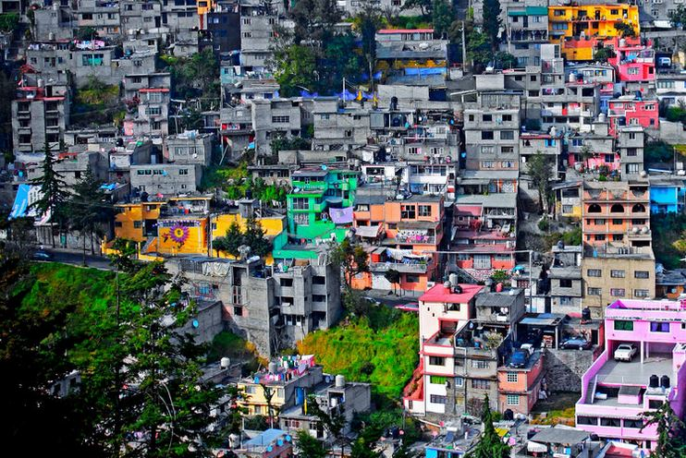
Project Overview
Data Source & Cleaning.
About Mexico and the Project.
Objective & Research Questions.

Slide 3
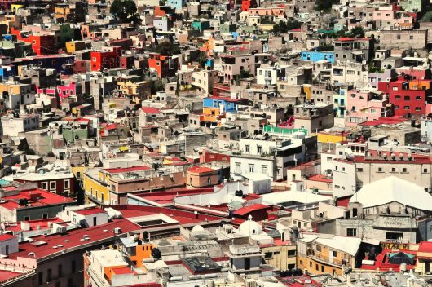
Data Source
Data was extracted from Kaggle.
Analysis Tool
The data will be transformed, cleaned, organized, concatenated, and analyzed using Python, an open-source programming language.

Slide 4

About Mexico and the Project
Mexico, officially the United Mexican States, is a country in the southern portion of North America.
With a population of almost 130 million, a rich cultural history and diversity, and abundant natural resources, Mexico is among the world's 15 largest economies country.
Currency: Mexican peso (‎MXN‎)‎.
Project
How is Housing in Mexico?
Does housing price predict/dictate the property size or location in Mexico?
The project would be posted on Git-hub for the public.

Slide 5

Objective
The main objective is to ascertain whether location or property size has a greater impact on sale prices.
Research Questions
Which state's real estate market is the most expensive?
Does the size of a house affect its price?

Slide 6


